Slide 1

Core Spring Framework

Slide 2
Agenda
Introduction to Spring framework
Introduction to containers managing beans
Dependency Injection and its ways
Bean Lifecycle
Auto wiring beans
Configuration based on Annotation
Integrating database

Slide 3
Why another framework?
Struts as MVC framework
Hibernate as ORM framework
Velocity at a view layer
Each of them has a specific purpose.
Integration is a big pain

Slide 4
What is Spring?
An open-source framework
Aims to make J2EE development easier
It is not a single tier framework like Struts or Hibernate
It helps the programmer across the applications in all tiers.
Can be used for stand-alone as well as Web development

Slide 5
Spring – Features
Dependency Injection(DI)
Inversion of control (IoC) : Loose coupling is achieved in spring using the technique Inversion of Control. The objects give their dependencies instead of creating or looking for dependent objects.
Aspect oriented (AOP) : Spring supports Aspect oriented programming and enables cohesive development by separating application business logic from system services.
Container : Spring contains and manages the life cycle and configuration of application objects.
Pluggable Modules: JDBC, AOP, MVC…

Slide 6
Modules in Spring
Spring provides around 20 modules such as,
Core
Context
AOP
DAO
ORM
Web MVC

Slide 7
Setting up Spring
Install JDK 1.8
Install Apache Common Logging API
Download and install from
http://commons.apache.org/logging/
Step up Eclipse IDE for J2EE
Setup Spring Framework libraries
Download Spring 5.X.Xjars from
www.springsource.org/download.
Notes:
We will use

Slide 8
Spring IoC Containers
The Spring container is at the core of the Spring framework
The container will create the objects, wire them together, configure them, and manage their complete lifecycle from creation to destruction.
The Spring container uses dependency injection (DI) technique to manage the components that make up an application.
Notes:
Talk a bit about each one of the module. You can alos introduce other module if needed

Slide 9
Spring IoC Containers

Slide 10
Spring Configuration metadata
There are three methods to provide configuration metadata to the container.
- XML based configuration
- Annotation based configuration
- Java based configuration

Slide 11
Types of Containers
Spring BeanFactory Container:
This is the simplest container providing basic support for DI and defined by the org.springframework.beans.factory.BeanFactory interface. The available implementations are,
ClassPathResource
FileSystemResource
ServletContextResource

Slide 12
Types of Containers
Spring ApplicationContext Container:
This container adds more enterprise-specific functionality such as the ability to
resolve text messages from a properties file
the ability to publish events to interested event listeners.
This container is defined by the org.springframework.context.ApplicationContext interface.
The implementations are :
ClassPathXmlApplicationContext
FileSystemXmlApplicationContext
XmlWebApplicationContext

Slide 13
An example using BeanFactory container

Slide 14
An example using ApplicationContext

Slide 15
Spring Bean Definition
Spring beans are the objects that form the backbone of the application and are managed by the IoC containers.
These beans are created from the configuration metadata that you supply to the container, in the form of xml file.
So, the IoC container instantiates, assemble and manage these beans.

Slide 16
Spring Bean Definition
We can configure a bean in XML as
<bean id="helloWorld“
class="com.oracle.HelloBean">
</bean>
By Default beans are Singleton

Slide 17
attributes of a <bean>
Properties | Descriptions
class | Specifies the bean class to be used to create the bean
name | Specifies the bean id(endifier)
scope | Specifies the scope of the objects created from a bean definition file
constructor-arg | This is used for DI, will be discussed later.
properties | This is also used for DI, will be discussed later.
autowiring mode | This is also used for DI, will be discussed later.
lazy-initialization mode | Informs the container to create the bean instance when it is first requested, rather than at startup. By default, lazy-init is false, meaning, the beans will be created eagerly
initialization method | A callback, will be discussed later.
destruction method | A calback to be called when the container containing the bean is destroyed, will be discussed later.

Slide 18
Spring Bean Scope
When defining a bean in Beans.xml, there is an option of declaring a scope for that bean.
For example, to request Spring to create a new bean instance every time it is needed, we can declare the bean’s scope as “prototype”.
Similarly, to request Spring to return the same bean instance every time it is needed, we can declare the bean’s scope as “singleton”.
Default is “singleton”.

Slide 19
Bean Scopes
Scope | Descriptions
singleton | Default scope. This creates a single instance of a bean and returns the same instance per Ioc Container.
prototype | This creates a new instance of a bean everytime it is needed. It creates any number of bean instances.
request | This is possible with web application. This scope is associated with HTTP request. Only valid in the context of a web-aware Spring ApplicationContext.
session | This is possible with web application. This scope is associated with HTTP session. Only valid in the context of a web-aware Spring ApplicationContext.
global-session | This is possible with web application. This scope is associated with global HTTP session. Only valid in the context of a web-aware Spring ApplicationContext. Applicable for portlets.

Slide 20
Setting Scope for a bean
This is the default scope
<bean id="..." class="..." scope="singleton">
<!-- other configurations go here -->
</bean>

Slide 21
An example setting scop

Slide 22
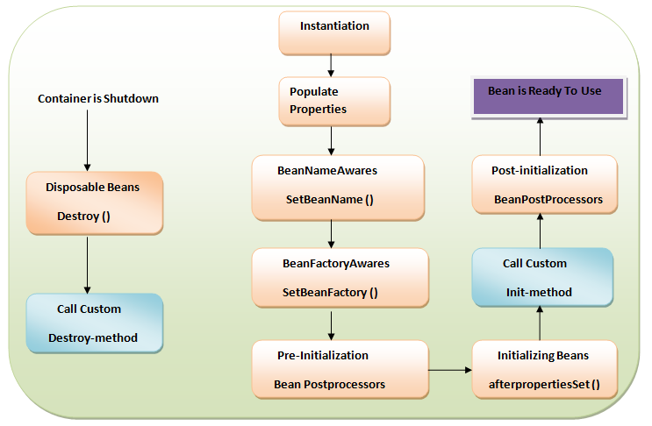
Spring Bean Life Cycle
Notes:
Take custom init, custom destroy methods
Demonstrate initilializing bean with call back methods
Demonstrate AbstractApplicationContext context=new ClassPathXmlApplicationContext("Beans.xml");
context.registerShutdownHook();

Slide 23
Demostrating Bean life cycle

Slide 24
Spring DI (Dependency Injection)
Every java based application has a few objects that work together to present what the end-user sees as a working application.
When writing a complex Java application, application classes should be as independent as possible of other Java classes to increase the possibility to reuse these classes and to test them independently of other classes while doing unit testing.
Dependency Injection (or sometime called wiring) helps in gluing these classes together and same time keeping them independent.

Slide 25
Types of Dependency Injection
Setter based dependency injection
Setter-based DI is accomplished by the container calling setter methods on your beans after invoking a no-argument constructor or no-argument static factory method to instantiate your bean.
Constructor based dependency injection
Constructor-based DI is accomplished when the container invokes a class constructor with a number of arguments, each representing a dependency on other class
Notes:
Discussed overloaded constructors and how to configure constructor based DI for index, name or type attributes
Discuss value attribute and ref attribute for both types if DI

Slide 26
An example Demonstrating DI

Slide 27
DI for Collections
You can use Java collections to be injected into beans. Spring offers four types of collection configuration elements which are as follows:
Elements | Descriptions
<list> | This helps in wiring ie injecting a list of values, allowing duplicates.
<set> | This helps in wiring a set of values but without any duplicates.
<map> | This can be used to inject a collection of name-value pairs where name and value can be of any type.
<props> | This can be used to inject a collection of name-value pairs where the name and value are both Strings.

Slide 28
Spring Beans auto-wiring
Autowiring feature of spring framework enables injecting the object type dependency implicitly for a bean.
It internally uses setter or constructor injection.
Type | Descriptions
no | It is the default autowiring mode. It means no autowiring bydefault.
byName | The byName mode injects the object dependency according to name of the bean.
byType | The byType mode injects the object dependency according to type.
constructor | The constructor mode injects the dependency by calling the constructor of the class.

Slide 29
An example using autowiring

Slide 30
Limitations of Auto-wiring mode
Overriding possibility: If you specify dependencies using <constructor-arg> and <property> settings, it will override auto-wiring.
Primitive data types: You cannot use auto-wiring for primitive data types and Strings.

Slide 31
Spring Annotation Based Configuration
What are annotations?
Annotations are basically passing some information about the program to JVM during run-time. These are prefixed with @ symbol. This passed information is called as “meta-data”.

Slide 32
Spring Annotation Based Configuration
In Spring, Annotation injection is performed before XML injection, thus the latter configuration will override the former for properties wired.
Annotation wiring is not turned on in the Spring container by default. So, before we can use annotation-based wiring, we will need to enable it in our Spring configuration file.

Slide 33
Enabling annotation
How to turn on annotation wiring?
Just include the following line in Beans.xml
<context:annotation-config/>

Slide 34
Stereotype annotations
These annotations are used to create Spring beans automatically in the application context.
Following are the stereotype annotations,
@Componenet : The annotation is applied to the class which holds the data being a POJO.
@Service: We specify a class with @Service to indicate that they’re holding the business logic. Besides being used in the service layer, there isn’t any other special use for this annotation. The utility classes can be marked as Service classes.
@Repository: We specify a class with @Repository to indicate that they’re dealing with CRUD operations, usually, it’s used with DAO (Data Access Object) or Repository implementations that deal with database tables.
@Controller: We specify a class with @Controller to indicate that they’re front controllers and responsible to handle user requests and return the appropriate response. It is mostly used with REST Web Services.

Slide 35
An example for stereotype annotations

Slide 36
Some important annotations
@Required – This applies to bean property setter methods.
@Autowired – This applies to bean property setter, non-setter methods, constructors and properties.
@Qualifier – This along with @Autowired can be specified exactly which bean needs to be wired.
JSR-250 Annotations – This includes @Resource, @PostConstruct, @PreDestroy annotations.

Slide 37
An example for auto wiring properties using @Autowired annotation
Notes:
Demonstrate @Autowired, @ Qualifier annotations

Slide 38
Spring Java based configuration
Java based configuration option enables you to write most of your Spring configuration without XML but with the help of few Java-based annotations.
Annotating a class with the @Configuration indicates that the class can be used by the Spring IoC container as a source of bean definitions.
The @Bean annotation tells Spring that a method annotated with @Bean will return an object that should be registered as a bean in the Spring application context.
Notes:
We need the following two additional jar files
CGLIB.jar from the Java installation directory
ASM.jar library which can be downloaded from the website

Slide 39
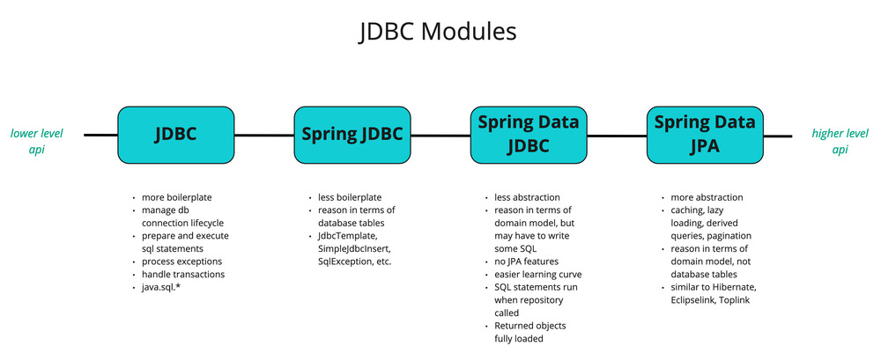
Accessing database

Slide 40
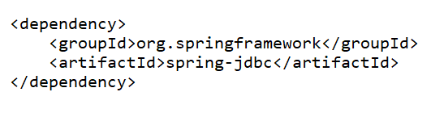
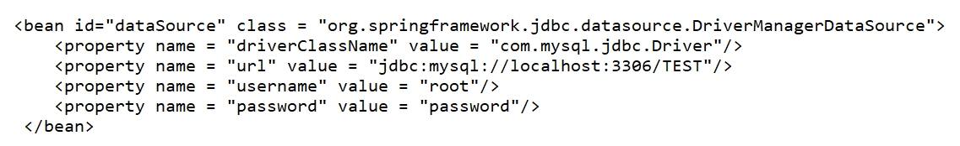
Beans for DataSource and JdbcTemplate

Slide 41
End of Part 1

Slide 42
T
H
A
N
K
Y
O
U

